Slide 1
Website design
Louis Gazo

Slide 2
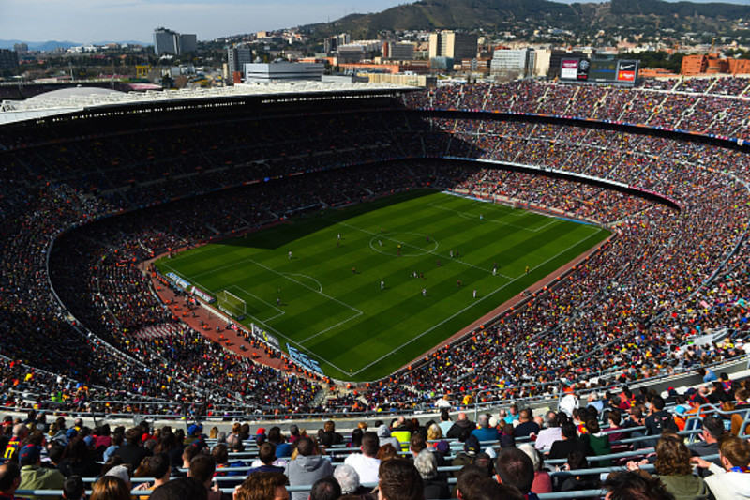
Futbol Stadiums
Gallery
Stadium Ranking
History
Geo Map
Champions League

Slide 3
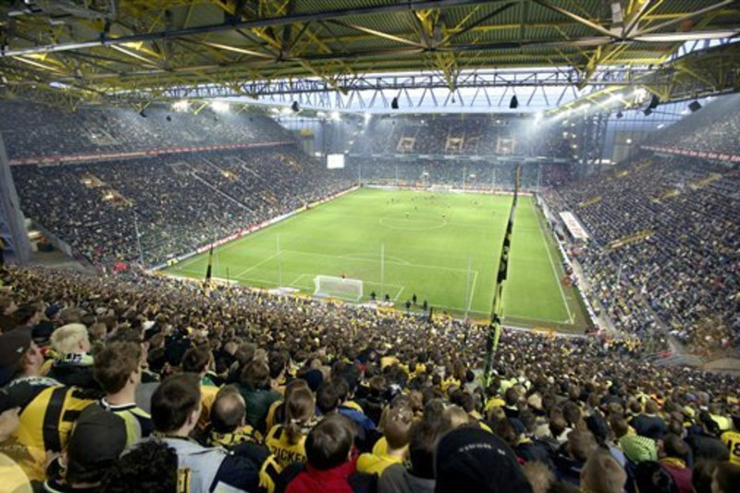
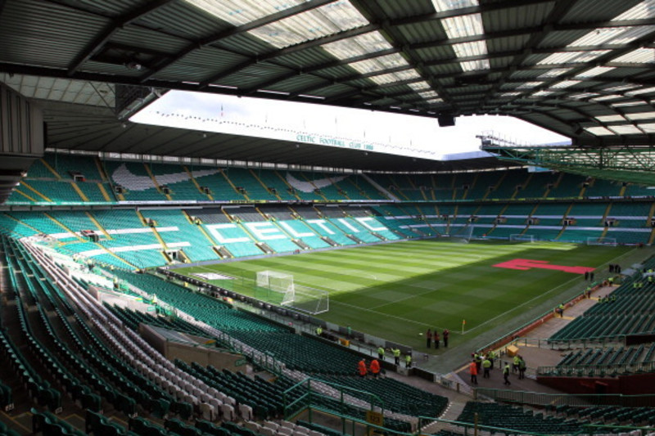
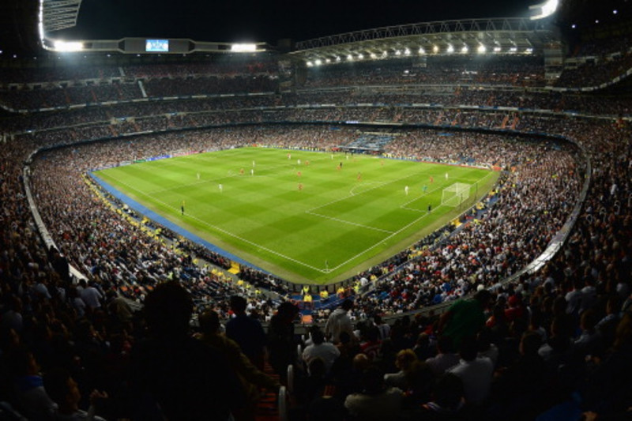
Futbol Stadiums
Gallery
Stadium Ranking
History
Geo Map
Champions League
GALLERY
Signal Iduna Park
Dortmund, Germany
Home of Borussia Dortmund
Celtic Park
Glasgow, UK
Home of Rangers FC
Santiago Bernabe
Madrid, Spain
Home of Real Madrid

Slide 4
Futbol Stadiums
Gallery
Stadium Ranking
History
Geo Map
Champions League
Stadium Ranking
Every stadium is different. The ranking system incorporates 4 key metrics for fans. The atmosphere, viewing, food & beverage, and surrounding area. The atmosphere includes the fan culture, chants, and proximity to the game pitch. Viewing includes the ability to see the game and any obstructions or odd angles. Food and beverage is more essential than one might consider as many fans enjoy a local taste as well as a pint or two. Food and beverage includes the expense as well as the quality. Finally, the surrounding area incorporates the town or city and whether this improves or decreases the value of the stadium.
#10
Built: 1971
Capacity: 81,365
Atmosphere: 10
Viewing: 9.2
Food & Beverage: 8.8
Surrounding Area: 9
In the tenth place is Borussia Dortmund’s stadium the Westfalenstadion.
Signal Iduna Park
Dortmund, Germany
Home of Borussia Dortmund

Slide 5
Futbol Stadiums
Gallery
Stadium Ranking
History
Geo Map
Champions League
Stadium History
Every stadium is different. The ranking system incorporates 4 key metrics for fans. The atmosphere, viewing, food & beverage, and surrounding area. The atmosphere includes the fan culture, chants, and proximity to the game pitch. Viewing includes the ability to see the game and any obstructions or odd angles. Food and beverage is more essential than one might consider as many fans enjoy a local taste as well as a pint or two. Food and beverage includes the expense as well as the quality. Finally, the surrounding area incorporates the town or city and whether this improves or decreases the value of the stadium.
Westfalenstadion has rich history. On 2 April 1974 - nine years after the official decision had been made – the Westfalenstadion was officially opened, with the stadium offering 54,000 predominantly standing spaces. The inauguration took place in a friendly match against Schalke 04. And the stadium has lost none of its aura since. Quite the opposite, in fact. Radio broadcasters rave about the “temple of German football” when they report from such a unique arena: the proximity to the pitch, the acoustics thanks to its complete roofing and the unique passion the fans in the Ruhr have for the beautiful game.
Signal Iduna Park
Dortmund, Germany
Home of Borussia Dortmund

Slide 6
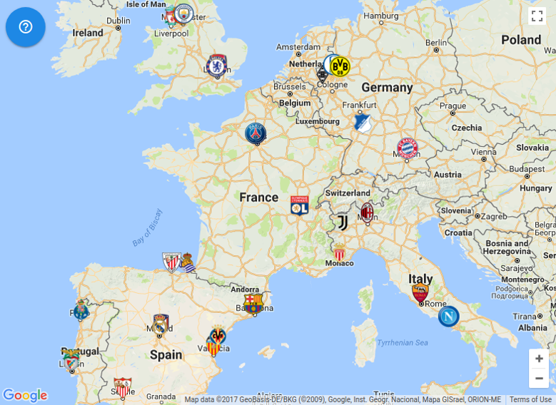
Futbol Stadiums
Gallery
Stadium Ranking
History
Geo Map
Champions League
GeoMap
Notes:
Ability to hover, link, and click on each stadium listed
Each stadium identified by an icon

Slide 7
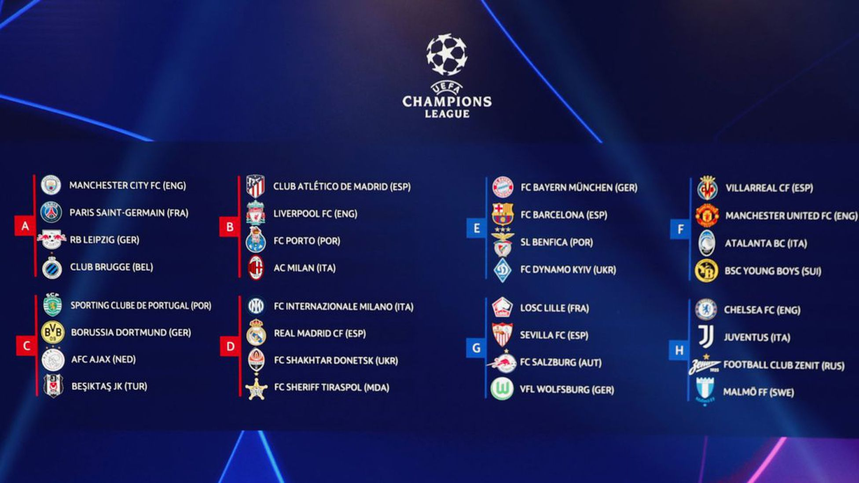
Futbol Stadiums
Gallery
Stadium Ranking
History
Geo Map
Champions League
Champions League
Updated and live feed of the Champions League groups and knockout round stages

Slide 8
SITEMAP
Stadium History
Scroll page
History of each stadium on gallery
Gallery
Images of stadiums
Linked to GeoMap
Just simple slideshow
Homepage
Gallery slideshow
5 links(gallery, ranking,history,geomap,CL)
Contact info @ bottom
GeoMap
Interactive map
Linked to gallery
Linked to stadium history
Shows where stadiums are in Europe
Ranking
Ranking including different information
Champions League
Additional Page showing results of champions league

